Slide 1
Introduction to 3D Printing
“ I want to say one word to you. Just one word.…
Plastics”
The Graduate - 1967

Slide 2
Introductions
Name
Favorite ice cream or desert

Slide 3
What is 3D Printing
Additive Manufacturing (Legos)
Subtractive (carving, milling)
Material is pushed through a nozzle (extruded)
Filament is heated to allow this to happen
Icing or pastry bag
Hot Glue gun

Slide 4
Uses for 3D Printers
Prototyping
Small lot manufacturing (cookie cutters)
Specialized or hard to find items (car parts)
Education (music, animals)
To be determined!

Slide 5
My Favorite Thing
It was a Saturday morning….

Slide 6
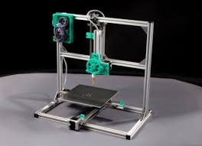
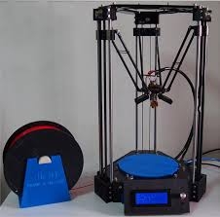
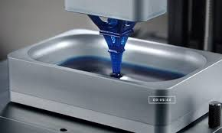
3D Pinter Types
Cartesian
Delta
DLP

Slide 7
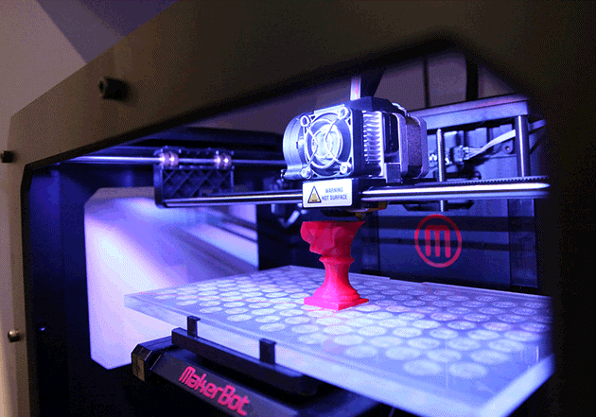
Cartesian

Slide 8
Delta

Slide 9

Delta Style Printer (video)
(https://www.youtube.com/watch?feature=player_embedded&v=zQxa920YGaU )

Slide 10
DLP

Slide 11
DLP Style Printer
(https://www.youtube.com/watch?feature=player_embedded&v=nxhUjPmxrP0 )

Slide 12
Money, Money, Money
Overall price range $300 - $2500+
Why the difference?
Technology (type) and build volume.

Slide 13
Money, Money, Money
FREE!
Boise Public Library
Online sign-up 2 hour slots
Meridian Library District (Unbound)
Send them your model

Slide 14
Differences
Technology (material)
Filament
PLA ($300 kit)
ABS (heated bed) (+$100)
Assembled (+$150)
Dual Head (+$200)
Resin (DLP)

Slide 15
Differences
Build Volume
4” x 4” x 4” ($300)
10” x 10” x 10” ($1000+)
7” x 15” x 7” DLP ($2500+)

Slide 16
Filament
Size 1.75mm (standard) & 3.00mm (old)
Material
PLA (Strong, stiff, fast print)
ABS (Heated bed, higher temp, slight flex)
Flex (rubber like)

Slide 17
Filament Exotics
Material
Nylon (Very Strong, very high print temp)
Wood
Conductive
Metallic (bronze, iron, etc)
Ceramic

Slide 18
What to Print?
You need a 3D model (.stl file)
Use an existing model
www.thingiverse.com
Make your own model
Tinkercad (web based)
OnShape (web based)
Meshmixer
Blender (open source)
Autocad 123D Design
openSCAD (open source; code based)

Slide 19
How to Print?
3D printers use GCode
Set of instructions (movement, speed, temp, etc)
(**** start.gcode for The Replicator, dual head ****)
M103 (disable RPM)
M73 P0 (enable build progress)
G21 (set units to mm)
G90 (set positioning to absolute)
M109 S065 T0 (set HBP temperature)
M104 S220 T0 (set extruder temperature) (temp updated by printOMatic)
…
G1 X-29.91 Y-29.91 Z0.1 F1080.0 E1.0
G1 X-23.5 Y-35.17 Z0.1 F1080.0 E1.3
G1 X-16.19 Y-39.08 Z0.1 F1080.0 E1.6
G1 X-8.25 Y-41.49 Z0.1 F1080.0 E1.9

Slide 20
Slicers
Convert Models to GCode
Cura (Ulitmaker)
Repetier (includes Slic3r )
Skeinforge used in ReplicatorG (oldie but a goodie)
KISSlicer
Makerware (Makerbot)
Simplify3D ($$$)

Slide 21
Terminology / Settings
Layer Height
Shells
Infill
Support
Skirt (brim)
Raft

Slide 22
Terminology / Settings
Layer Height
0.1 mm, (fine)
0.2 mm, (med)
0.3 mm (coarse)

Slide 23
Bed Leveling is Important
Layer height (0.1, 0.2, 0.3mm)
1/64” ~ 0.4mm
Sheet of paper is ~ 0.05mm thick

Slide 24
Terminology / Settings
Shells –
How many layers around the outside
1,2,…? (2 is common, 4 or more extreme)

Slide 25
Terminology / Settings
Infill –
10% - 100%
10% - 20% is common

Slide 26
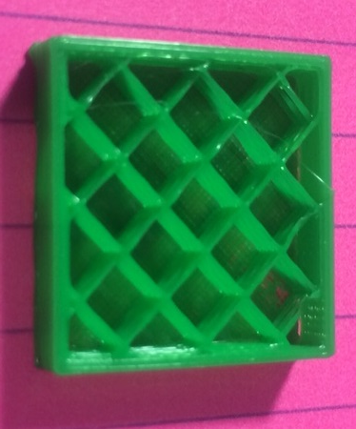
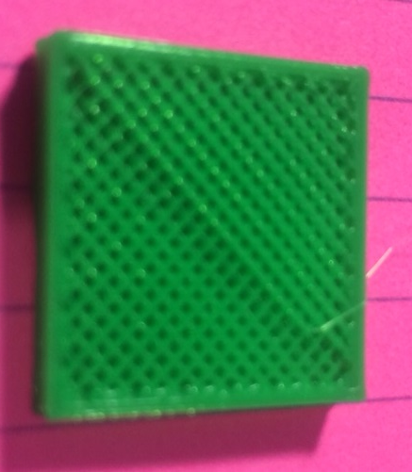
Infill
10%
40%

Slide 27
Terminology / Settings
Support
Printed material that is not part of the finished model
scaffolding

Slide 28
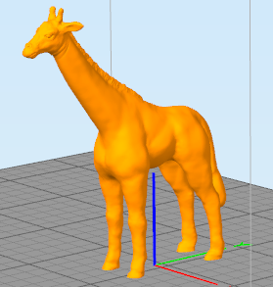
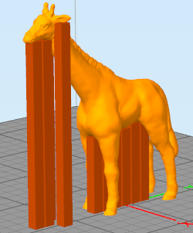
Support
Overhangs

Slide 29
Terminology / Settings
Skirt (brim)
Raft
These are both used to help the model stick to the build platform and reduce warping

Slide 30
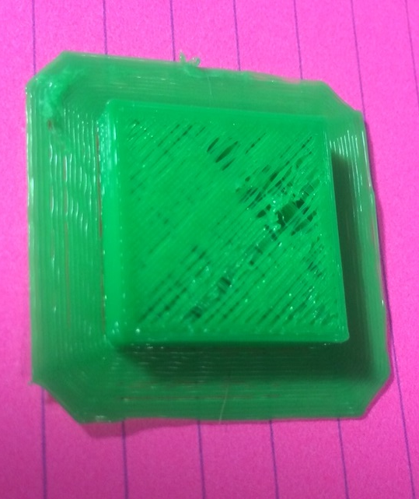
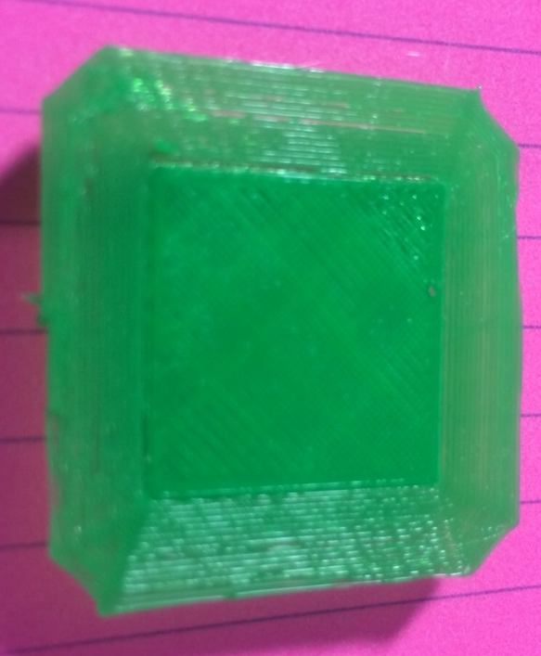
Skirt / Brim
Top
Bottom

Slide 31
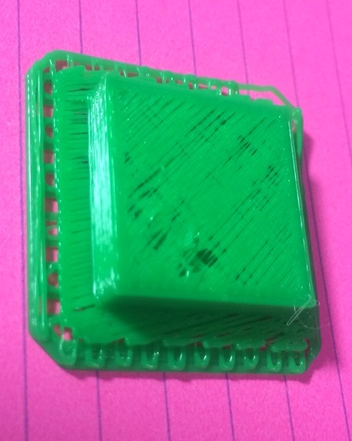
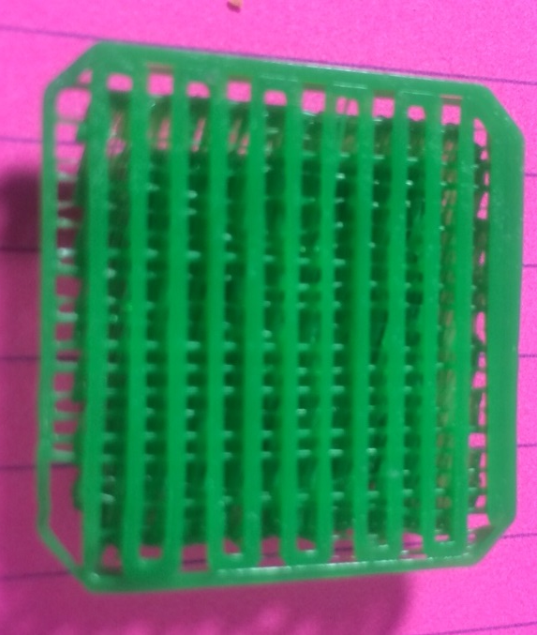
Raft
Top
Bottom

Slide 32
Stick It
First layer is the most important layer
Getting the first layer to adhere to the print bed
Painters tape (blue tape) – PLA only
Glass with hairspray
Kapton tape
ABS juice (ABS and acetone)

Slide 33
Danger! Danger! Will Robinson!
Plastic | Bed / Table |  | Nozzle
 | C | F | C | F
PLA | 0 – 65 | 0 - 149 | 200 - 210 | 392 – 410
ABS | 110 – 115 | 230 - 239 | 225 - 235 | 437 - 455

Slide 34
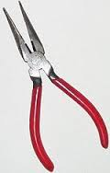
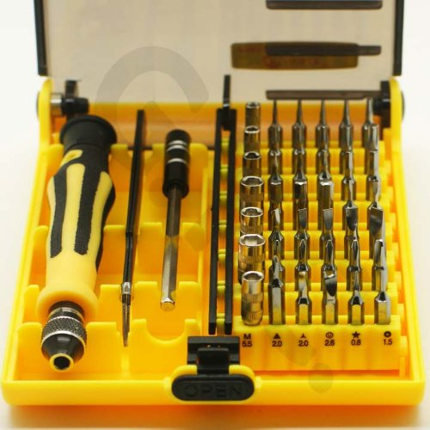
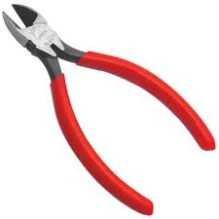
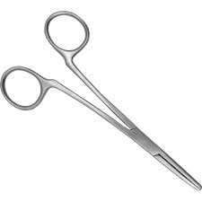
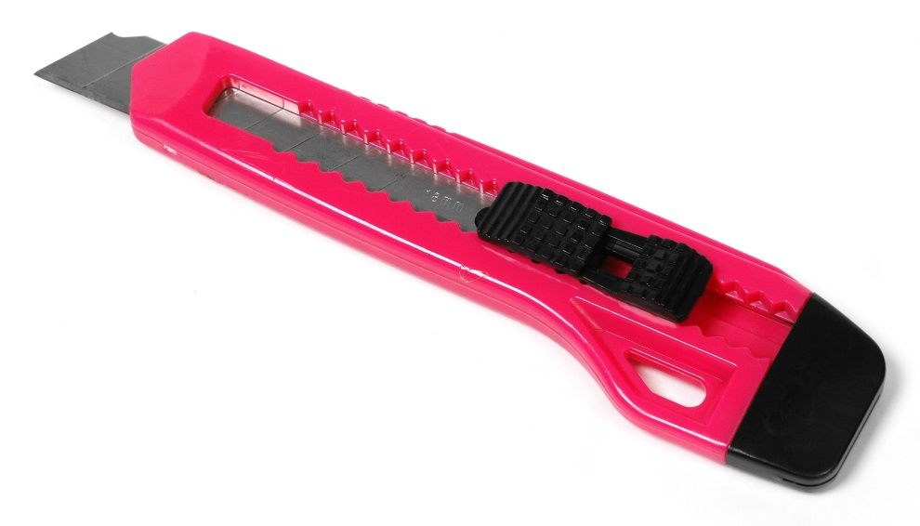
Common Tools

Slide 35
How Many ‘x’ Can I Print?
Matter is neither created nor destroyed
A standard spool of filament is 1kg (2.2 pounds)
Ukulele weighs about 425g (0.425kg) so it took just under half a spool of filament.
A cookie cutter weighs < 10g
1000g / 10 = 100 so you can print about 100 cookie cutters from a single 1kg (1000g) spool of filament.

Slide 36
Questions!

